Slide 1
Understanding convolution

Slide 2
Understanding convolution - Overview

Slide 3
Understanding convolution - Inputs
Input image [7 x 7 x 3]
[h x w x d]
height
width
depth

Slide 4
Understanding convolution - Inputs
Input image [7 x 7 x 3]
Zero pad : 1
Stride : 2
[h x w x d]
height
width
depth

Slide 5
Understanding convolution - Filters
Filter size [2 x 3 x 3 x 3]
[o x h x w x d]
# of filters
height
width
depth

Slide 6
Understanding convolution - Outputs
Output size [3 x 3 x 2]
[h x w x d]
height
width
depth

Slide 7
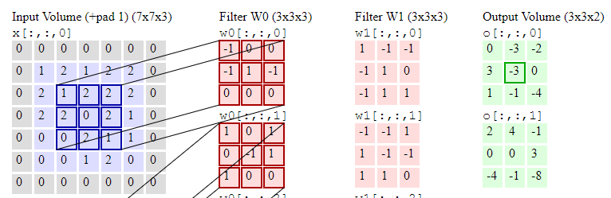

Understanding convolution - Outputs
Output size [3 x 3 x 2]
[h x w x d]
height
width
depth
1 | 2 | 2
2 | 0 | 2
0 | 2 | 1
-1 | 0 | 0
-1 | 1 | -1
0 | 0 | 0
1*(-1)=-1 | 2*0=0 | 2*0=0
2*(-1)=-2 | 0*1=0 | 2*(-1)=-2
0*0=0 | 2*0=0 | 1*0=0
*
=
+
1
+
1

Slide 8
Understanding convolution - Outputs
Output size [3 x 3 x 2]
[h x w x d]
height
width
depth

Slide 9



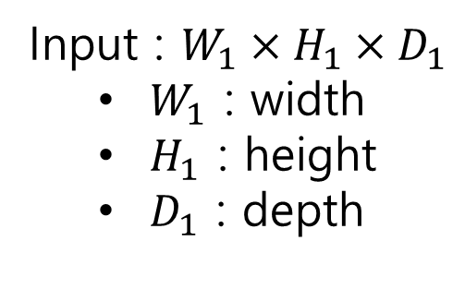


Understanding convolution – Getting output size
Input : $W_{1}×H_{1}×D_{1}$
$W_{1}$ : width
$H_{1}$ : height
$D_{1}$ : depth
Filters : $K@(F×F×D_{1})$
$K$ : no. of filters
$F$ : filter height/depth
$D_{1}$ : filter depth
$S$ : filter stride
Output :$W_{2}×H_{2}×D_{2}$
$W_{2}$ : output width
$H_{2}$ : output height
$D_{2}$ : output depth
$$W_{2}=\frac{W_{1}−F+2P}{S}+1$$
$$H_{2}=\frac{H_{1}−F+2P}{S}+1$$
$$D_{2}=K$$

Slide 10
Understanding convolution – Getting output size
Input : $W_{1}×H_{1}×D_{1}$
$W_{1}$ : width
$H_{1}$ : height
$D_{1}$ : depth
Filters : $K@(F×F×D_{1})$
$K$ : no. of filters
$F$ : filter height/depth
$D_{1}$ : filter depth
$S$ : filter stride
Output :$W_{2}×H_{2}×D_{2}$
$W_{2}$ : output width
$H_{2}$ : output height
$D_{2}$ : output depth
$$W_{2}=\frac{W_{1}−F+2P}{S}+1$$
$$H_{2}=\frac{H_{1}−F+2P}{S}+1$$
$$D_{2}=K$$

Slide 11
Understanding convolution – Getting output size
Input : $W_{1}×H_{1}×D_{1}$
$W_{1}$ : width
$H_{1}$ : height
$D_{1}$ : depth
Filters : $K@(F×F×D_{1})$
$K$ : no. of filters
$F$ : filter height/depth
$D_{1}$ : filter depth
$S$ : filter stride
Output :$W_{2}×H_{2}×D_{2}$
$W_{2}$ : output width
$H_{2}$ : output height
$D_{2}$ : output depth
$$W_{2}=\frac{W_{1}−F+2P}{S}+1$$
$$H_{2}=\frac{H_{1}−F+2P}{S}+1$$
$$D_{2}=K$$

Slide 12
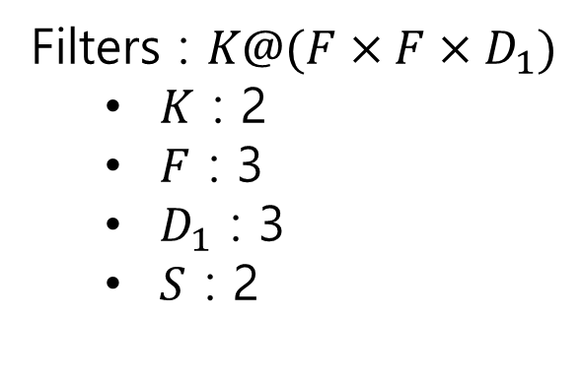
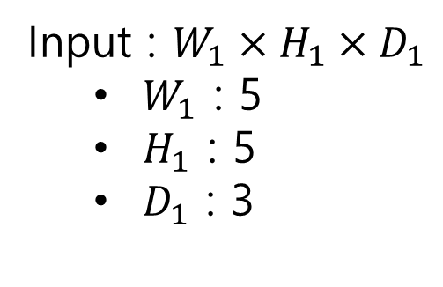



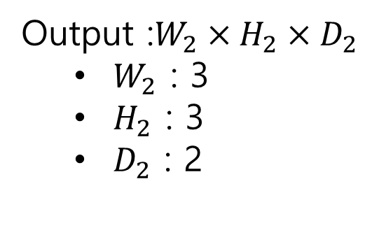
Understanding convolution – Getting output size
Input : $W_{1}×H_{1}×D_{1}$
$W_{1}$ : 5
$H_{1}$ : 5
$D_{1}$ : 3
Filters : $K@(F×F×D_{1})$
$K$ : 2
$F$ : 3
$D_{1}$ : 3
$S$ : 2
Output :$W_{2}×H_{2}×D_{2}$
$W_{2}$ : 3
$H_{2}$ : 3
$D_{2}$ : 2
$$W_{2}=\frac{5−3+2}{2}+1=3$$
$$H_{2}=\frac{5−3+2}{2}+1=3$$
$$D_{2}=2$$

Slide 13
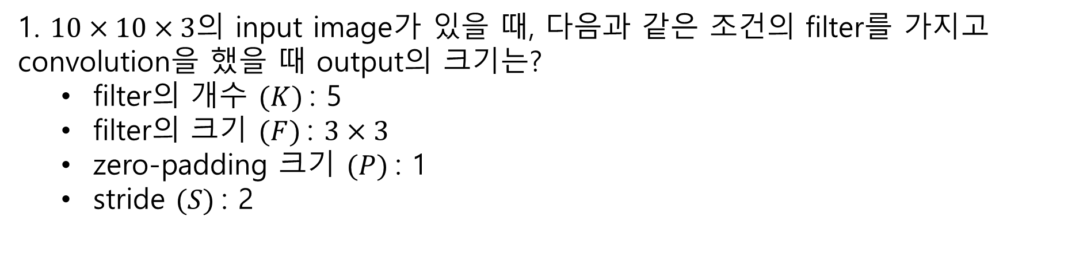



Understanding convolution – Quiz
1. $10×10×3의$ input image가 있을 때, 다음과 같은 조건의 filter를 가지고 convolution을 했을 때 output의 크기는?
filter의 개수 $(K)$: 5
filter의 크기 $(F)$: $3×3$
zero-padding 크기 $(P)$: 1
stride $(S)$: 2
$$W_{2}=\frac{W_{1}−F+2P}{S}+1$$
$$H_{2}=\frac{H_{1}−F+2P}{S}+1$$
$$D_{2}=K$$

Slide 14

Understanding convolution – Quiz
1. $10×10×3의$ input image가 있을 때, 다음과 같은 조건의 filter를 가지고 convolution을 했을 때 output의 크기는?
filter의 개수 $(K)$: 5
filter의 크기 $(F)$: $3×3$
zero-padding 크기 $(P)$: 1
stride $(S)$: 2
$$W_{2}=\frac{W_{1}−F+2P}{S}+1$$
$$H_{2}=\frac{H_{1}−F+2P}{S}+1$$
$$D_{2}=K$$
$$W_{2}=H_{2}=\frac{10−5+2}{2}+1=\frac{7}{2}+1=3.5+1=4.5→4$$
$$D_{2}=K=4$$

